Slide 1

SIG Choreografie

Slide 2

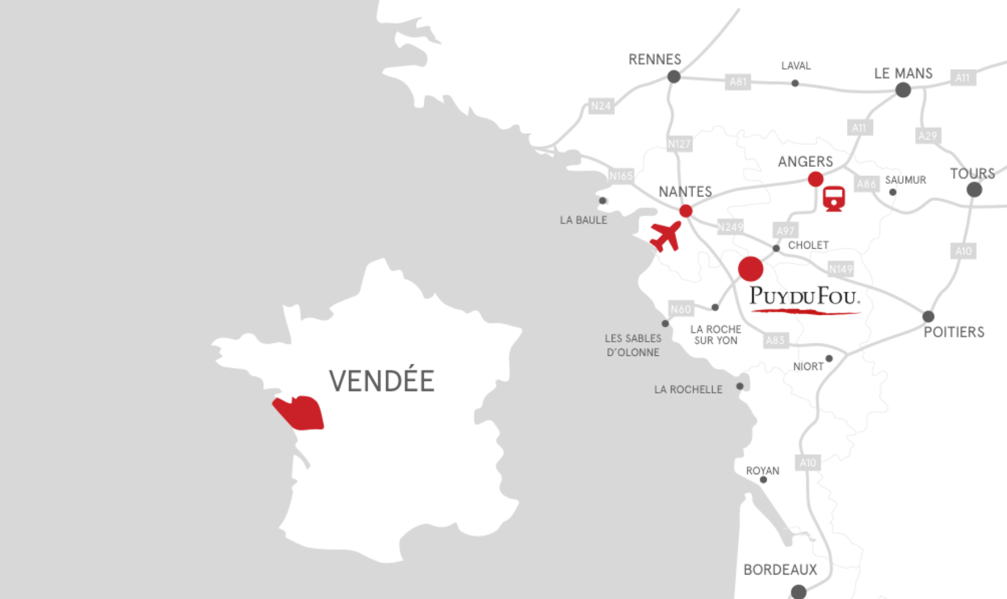
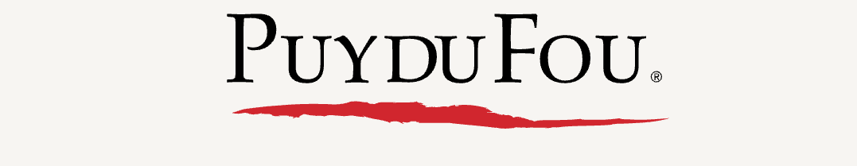
Choreografie

Slide 3
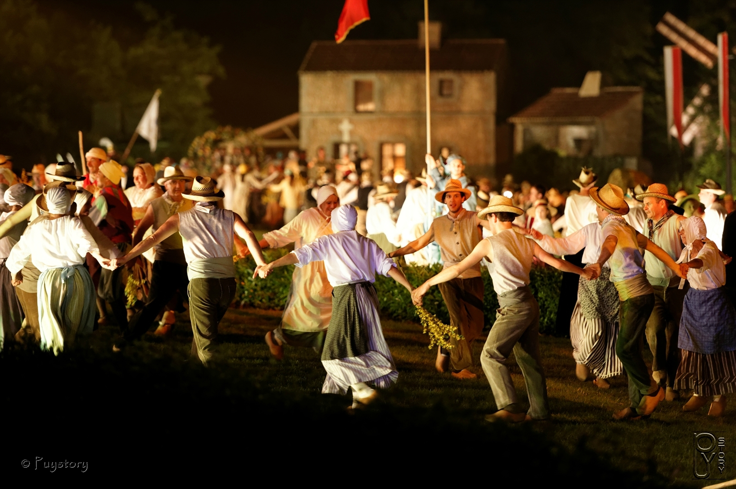
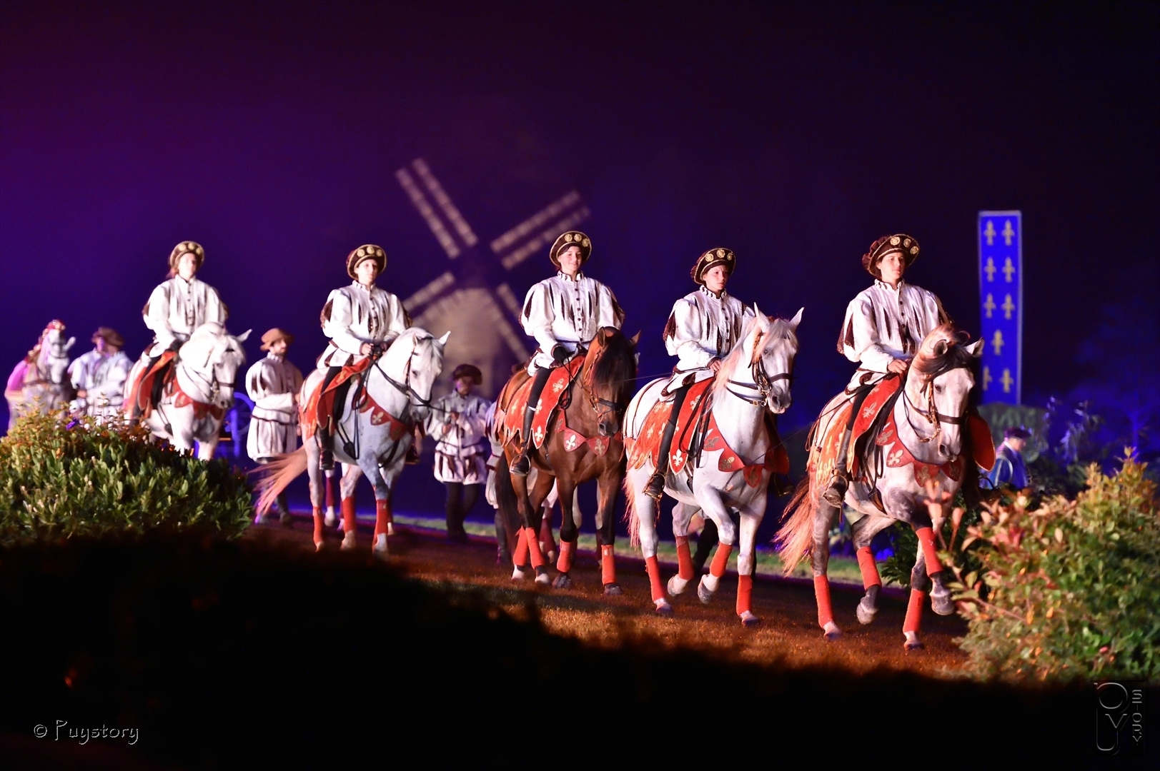
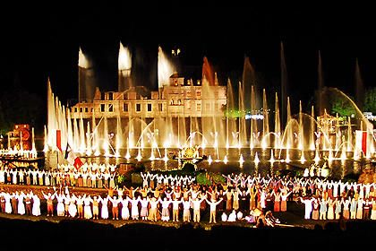
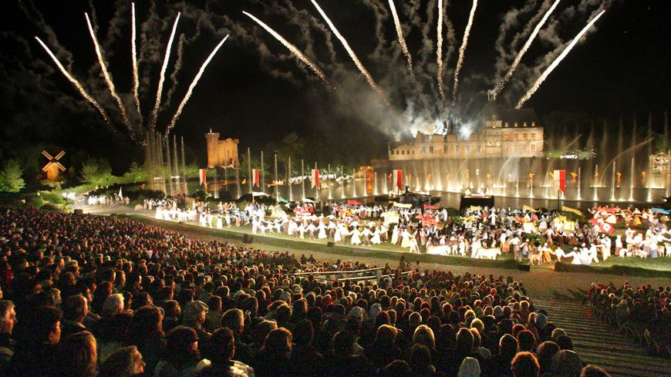

Puy du fou

Slide 4

Programma
Introductie:
Events:
Transacties en domeinen
Notificaties
Cqrs patroon
Event sourcing
Aggregates
Saga
Handson : Event sourcing : Java+springboot micro services with axon framework: implementeren van een saga

Slide 5
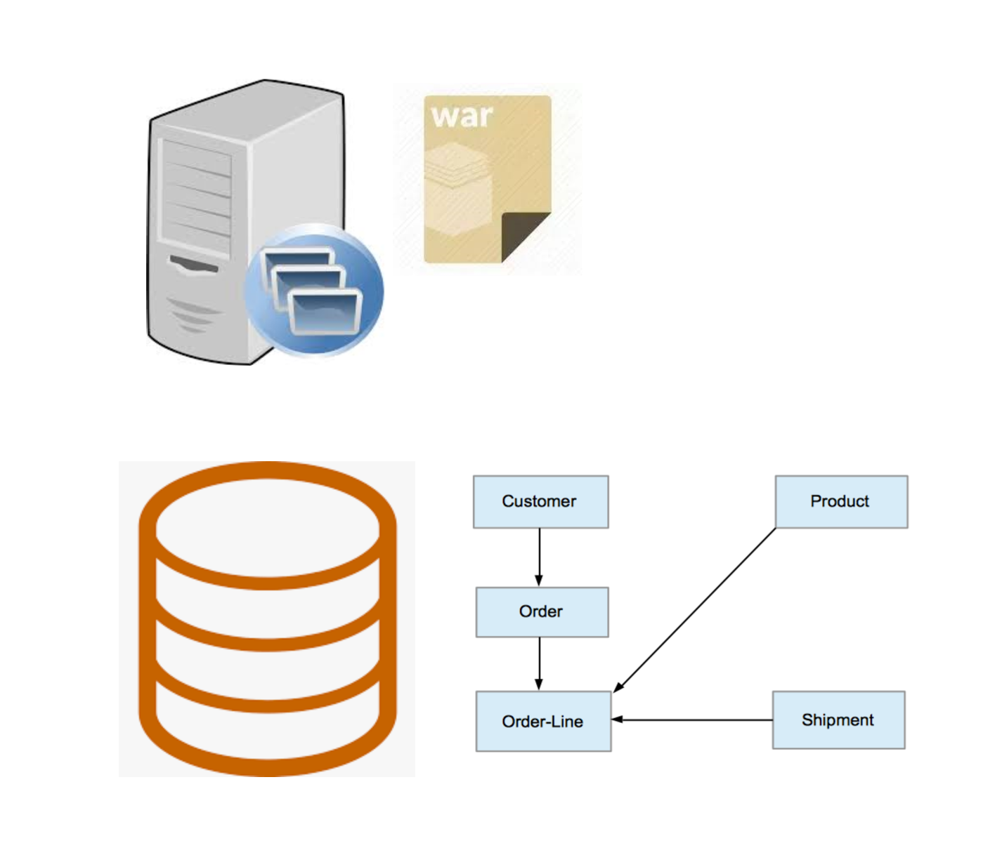
Enterprise systems : nog niet zo lang geleden

Slide 6
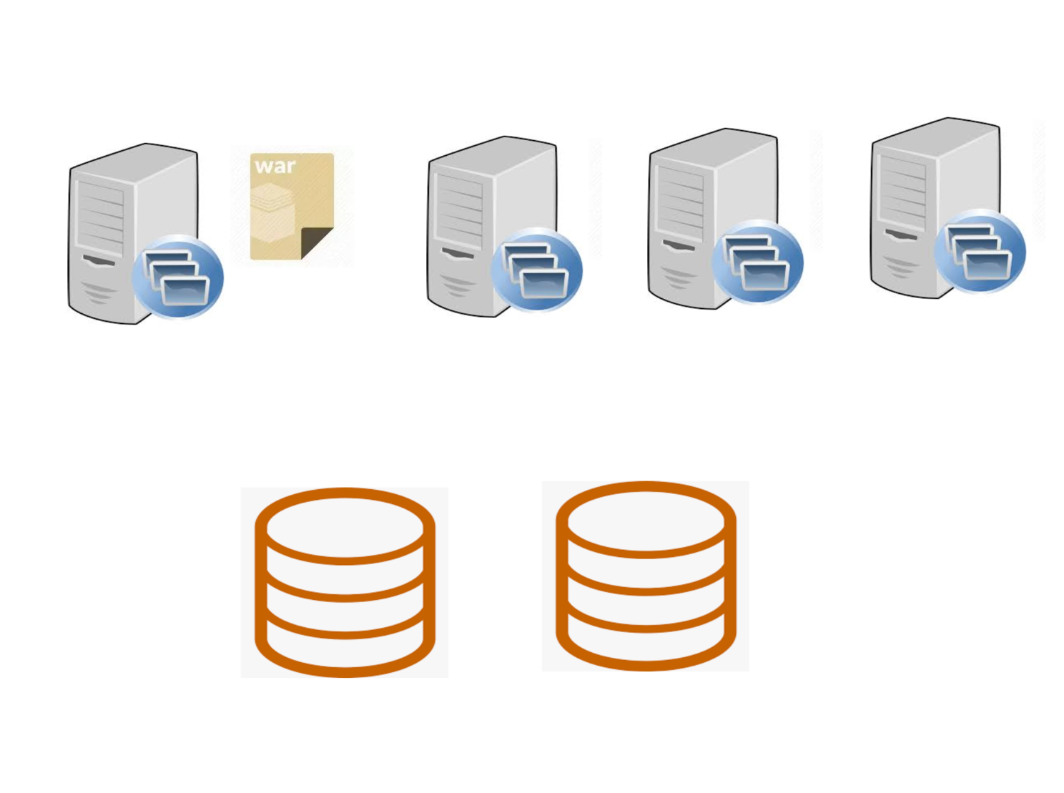
Horizontale schaling

Slide 7
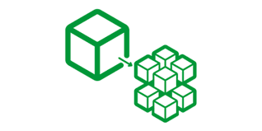
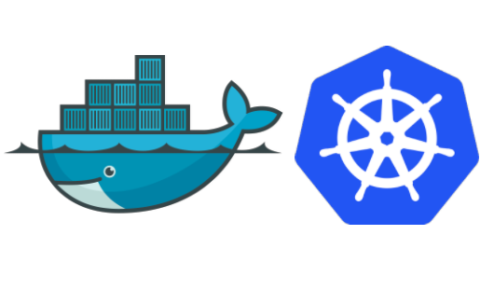
Moderne enterprise systems

Slide 8
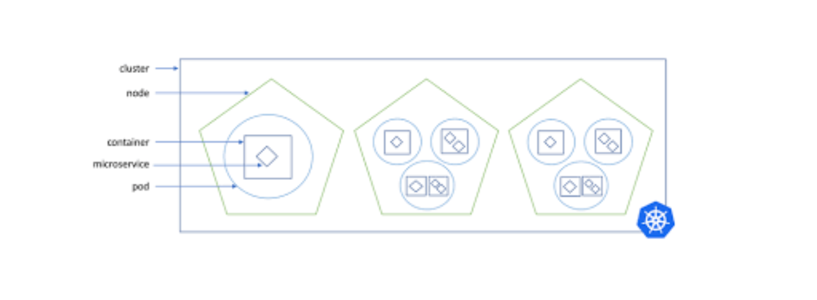
Kubernetes cluster

Slide 9

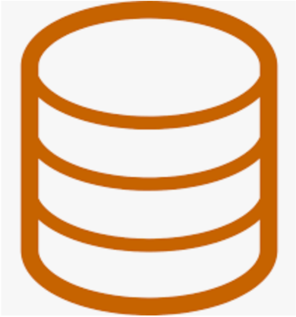
Service instances
Instance #1 of service A
Instance #2 of service A
Instance #n of service A
database per service

Slide 10
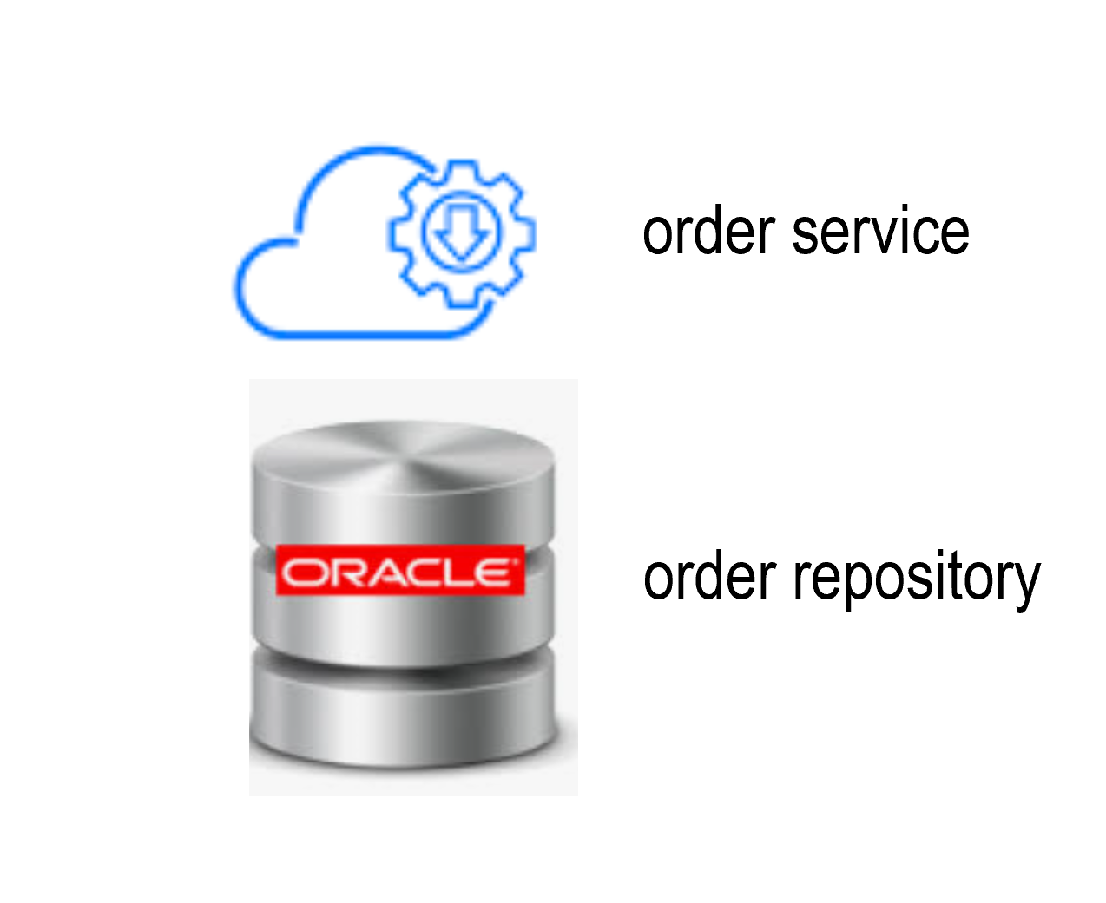
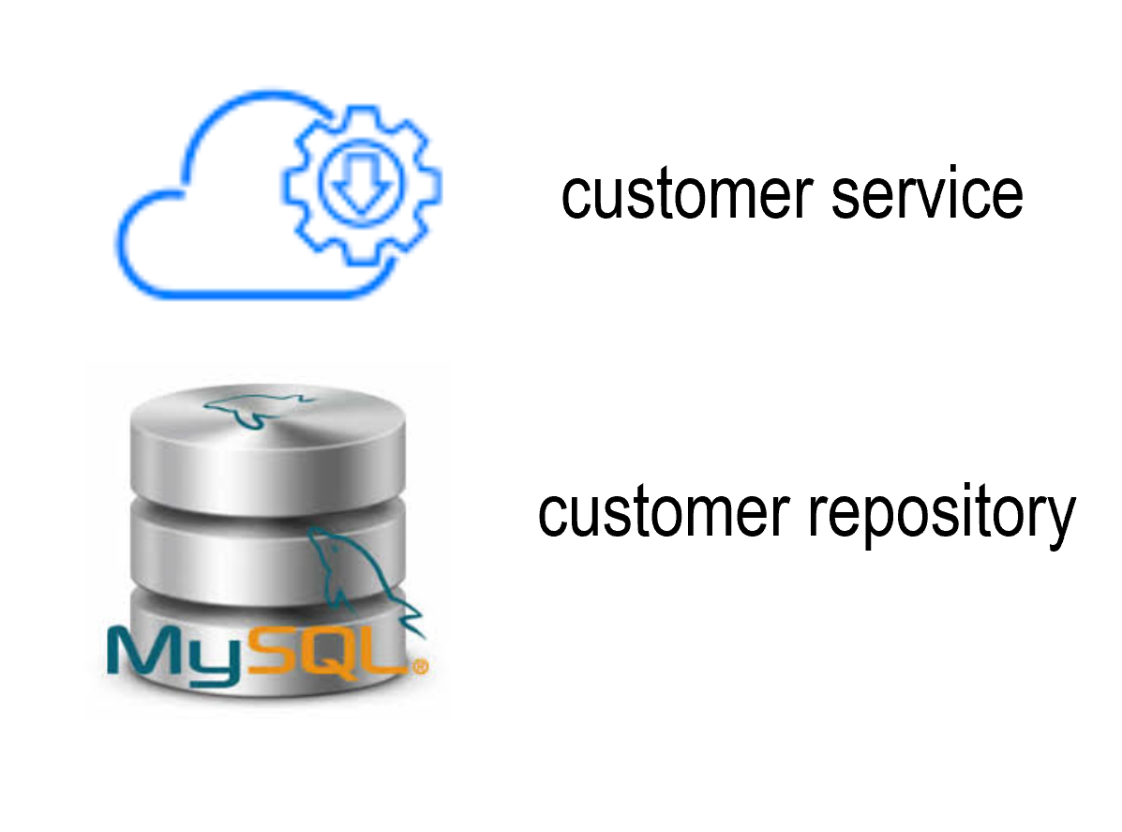
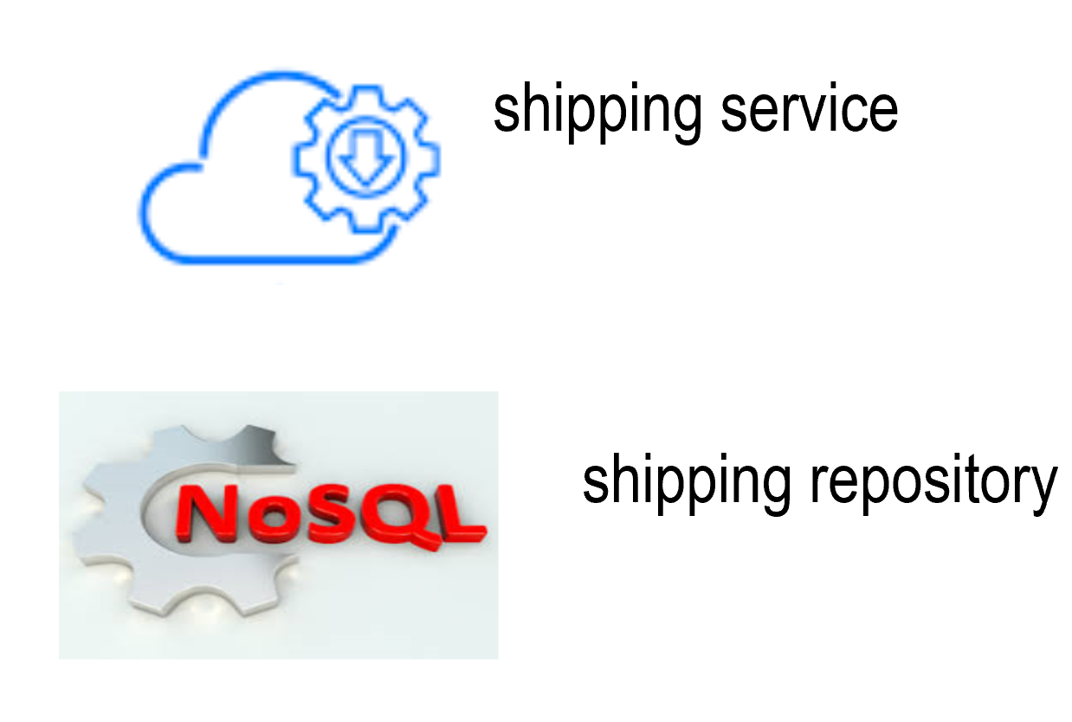
Domain driven design

Slide 11
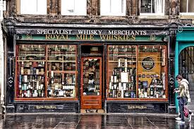
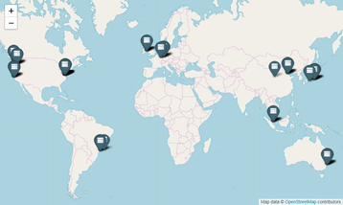



Transactions
Local
Distributed

Slide 12
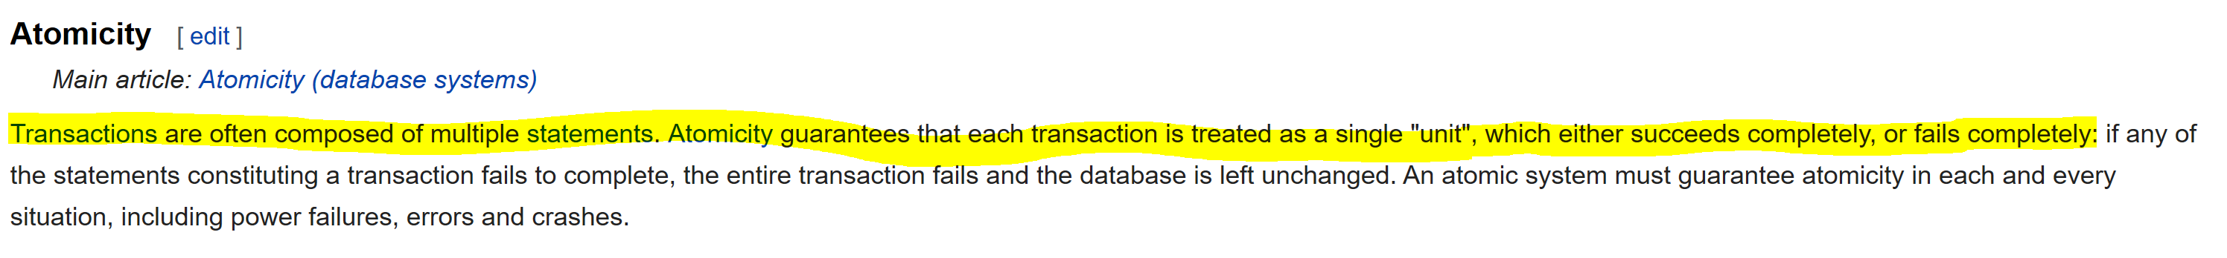
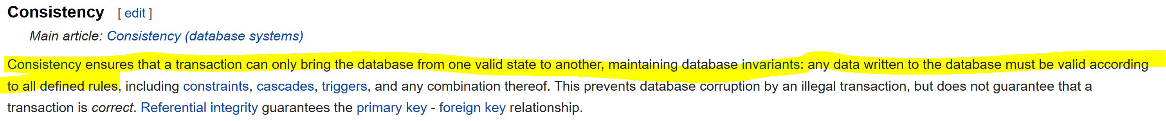
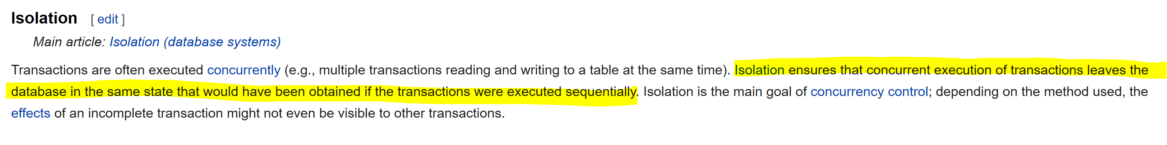

Slide 13
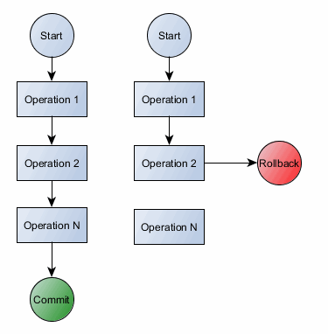
Voorbeeld

Slide 14
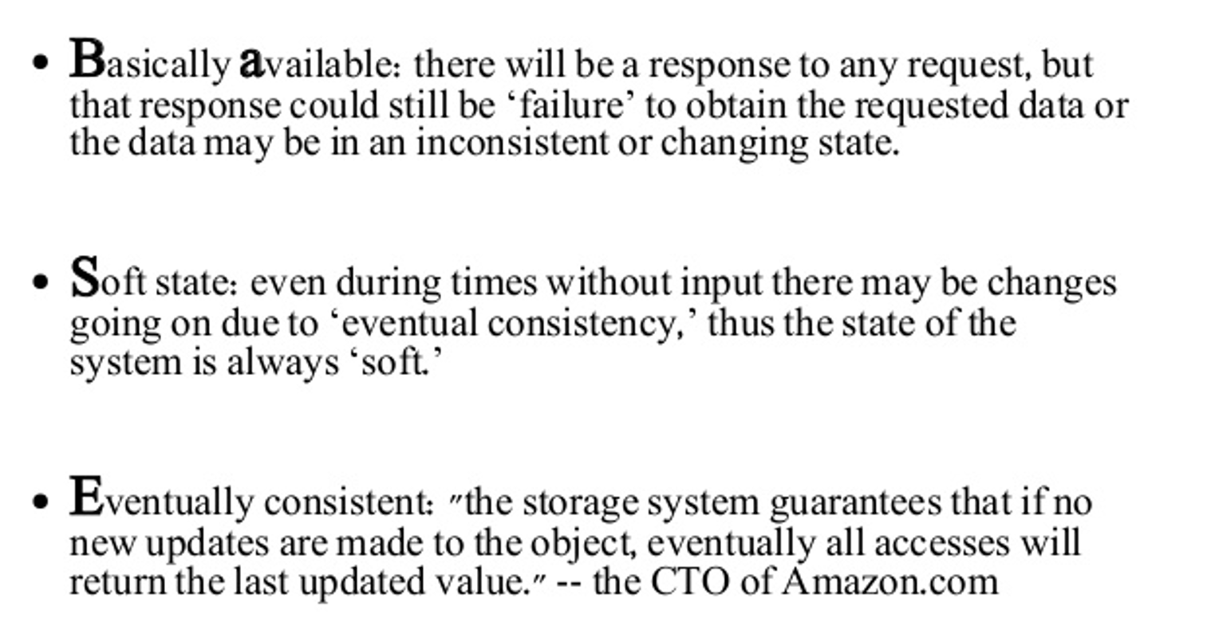

Slide 15
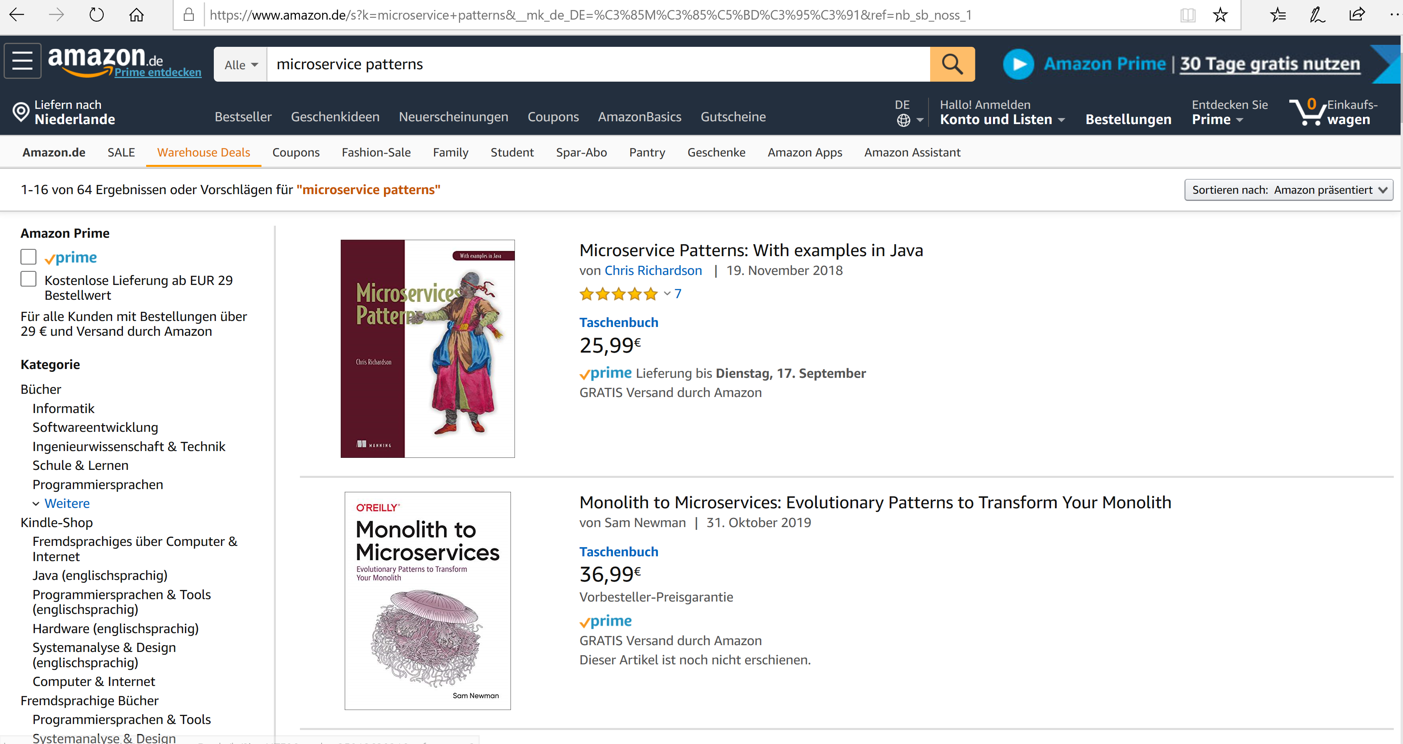
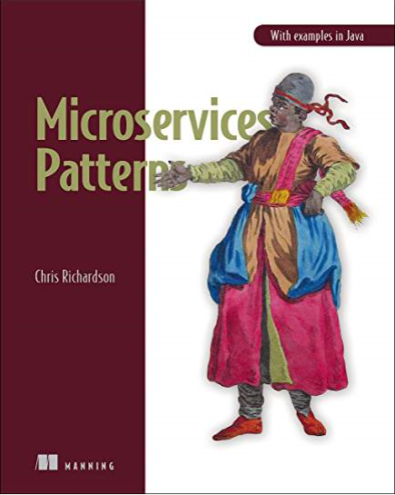
Voorbeeld

Slide 16
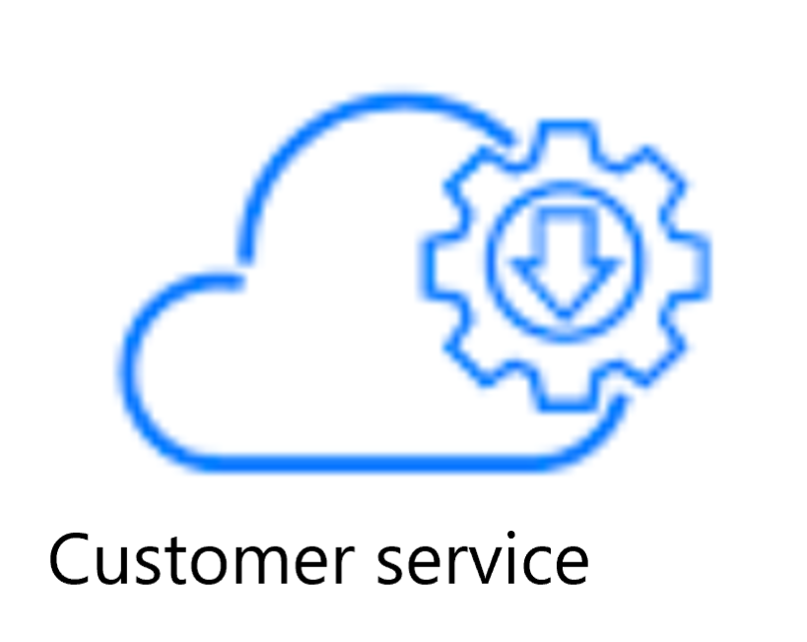


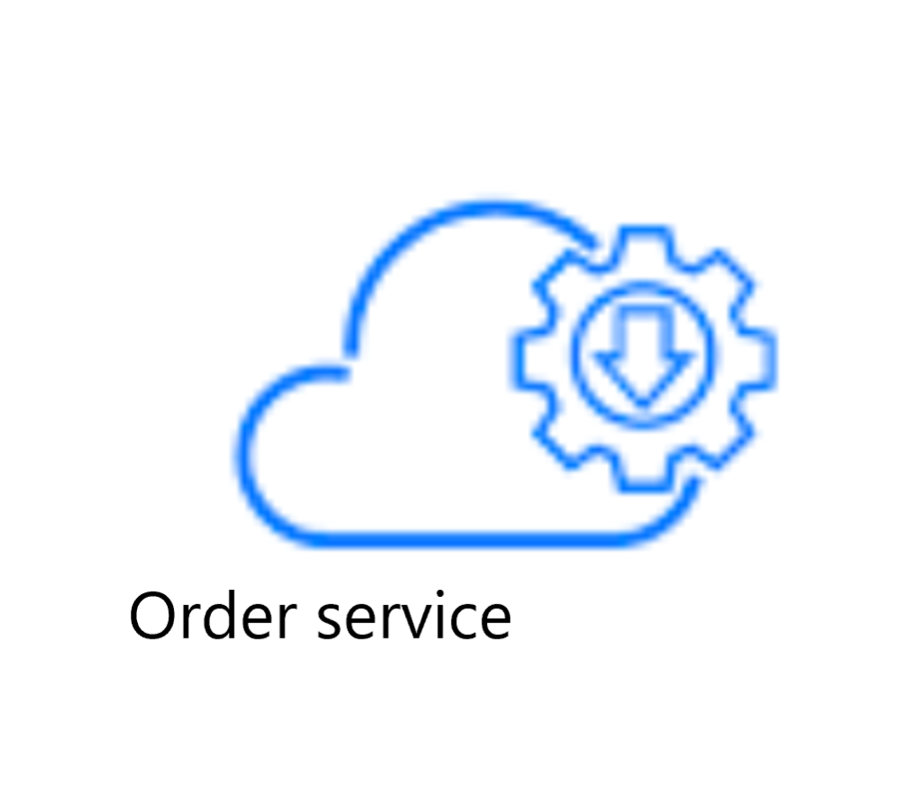
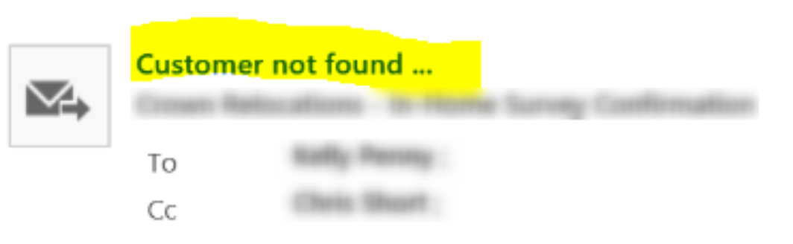
Uiteindelijke consistentie

Slide 17

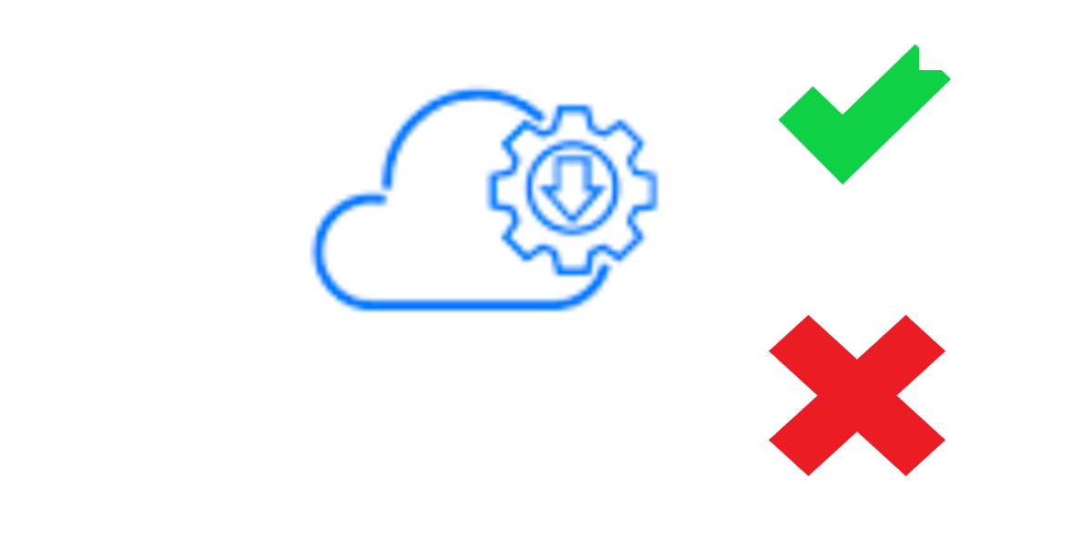
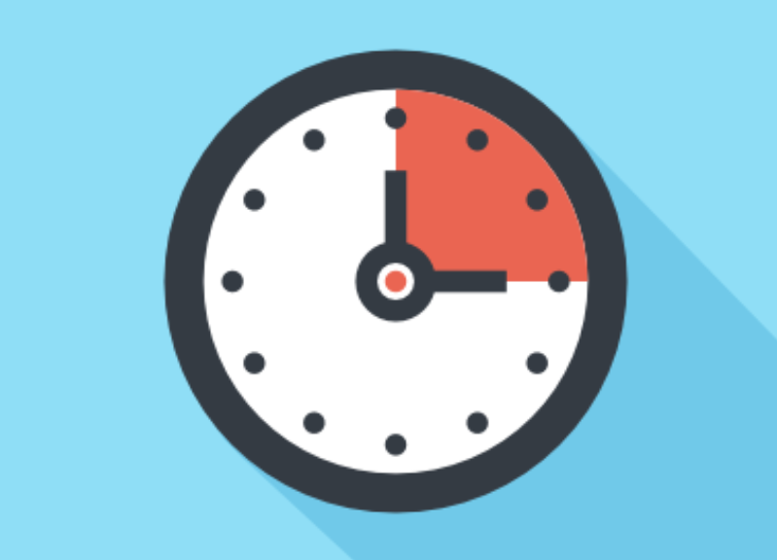

Uiteindelijke consistentie : rebound

Slide 18
Eric Brewer’s CAP theorie
Purpose : creating awareness of the trade-offs while designing networked shared-data systems
Consistency
A guarantee that every node in a distributed cluster returns the same, most recent, successful write. (A service that is consistent operates fully or not at all)
Availability
Availability means just that - the service is available (to operate fully or not as above). Every non-failing node returns a response for all read and write requests in a reasonable amount of time
Partition Tolerance
Gilbert & Lynch defined partition tolerance as:
No set of failures less than total network failure is allowed to cause the system to respond incorrectly

Slide 19
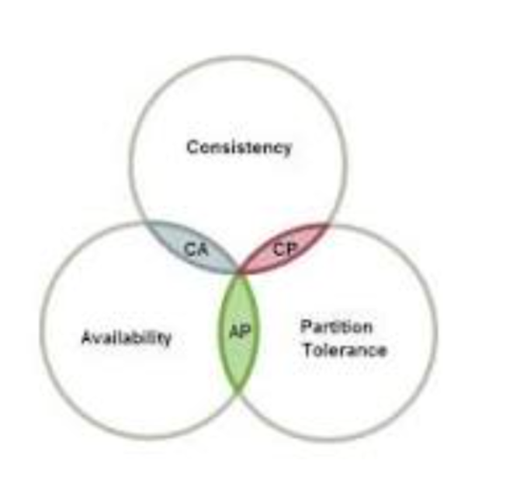
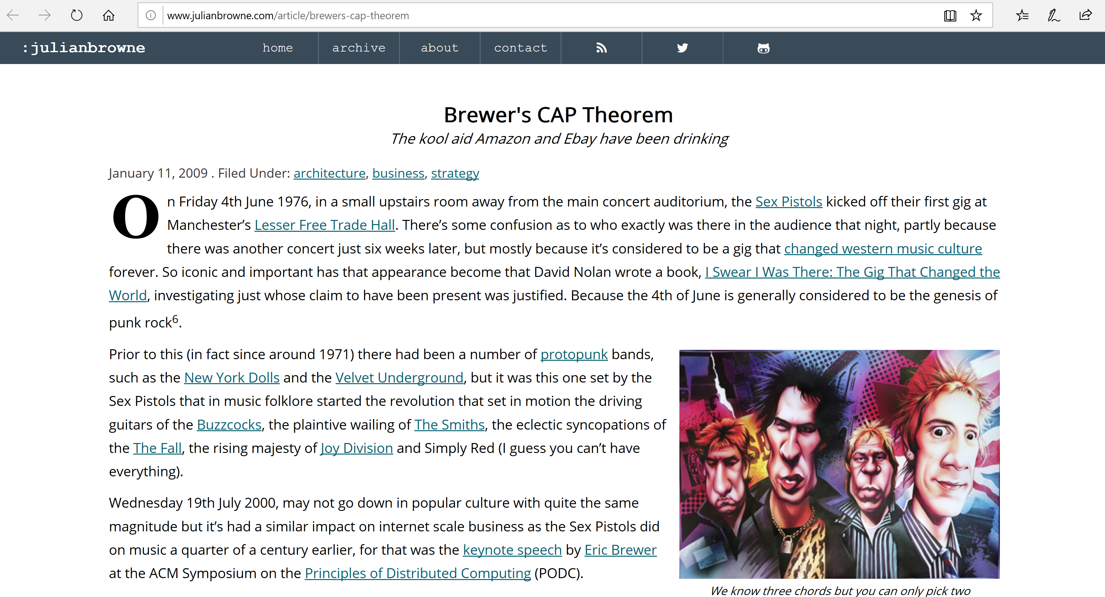
Eric Brewer’s CAP theorie
Categorizes distributed systems in 2 out of 3
Available & Partition tolerant
These are systems that are available and partition tolerant but cannot guarantee consistency
Consistent & Available
CA systems are consistent and available systems in the absence of any network partition. Often a single node's DB servers are categorized as CA systems
Consistent & Partition tolerant
CP is referring to a category of systems where availability is sacrificed only in the case of a network partition. So, when a network partition goes down, availability might reduce.

Slide 20
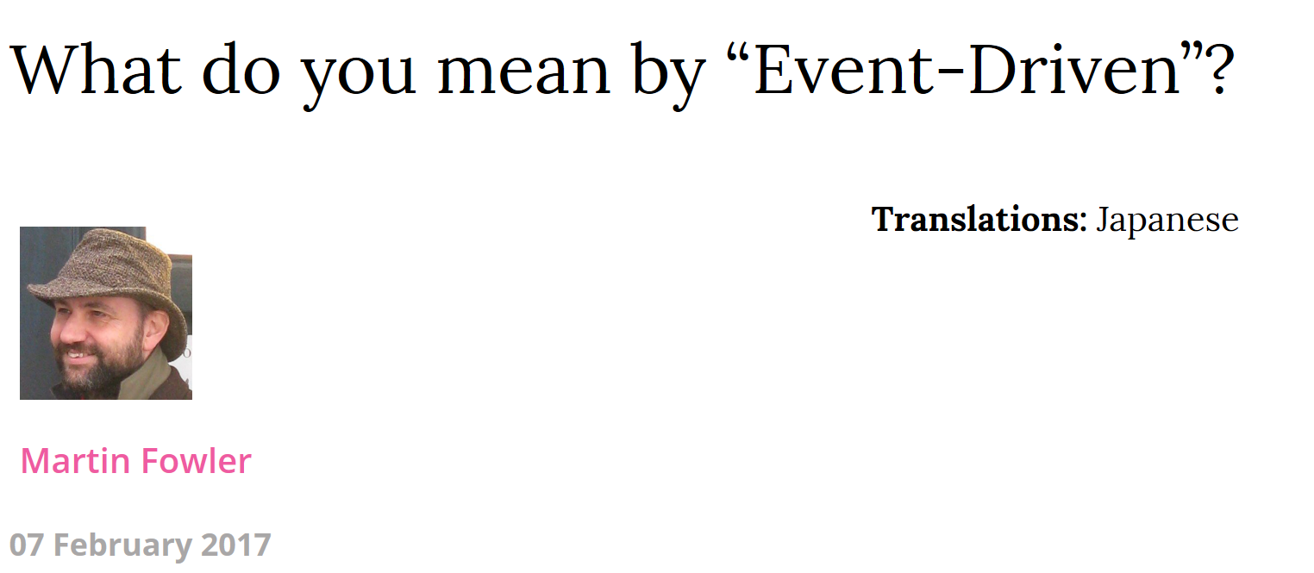
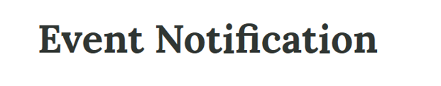
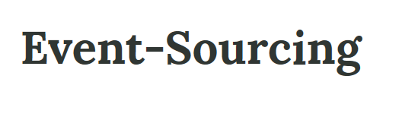
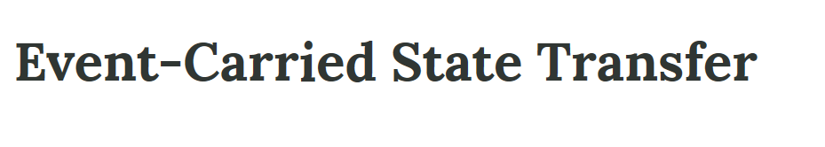
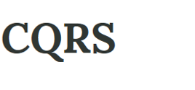
Martin Fowler

Slide 21
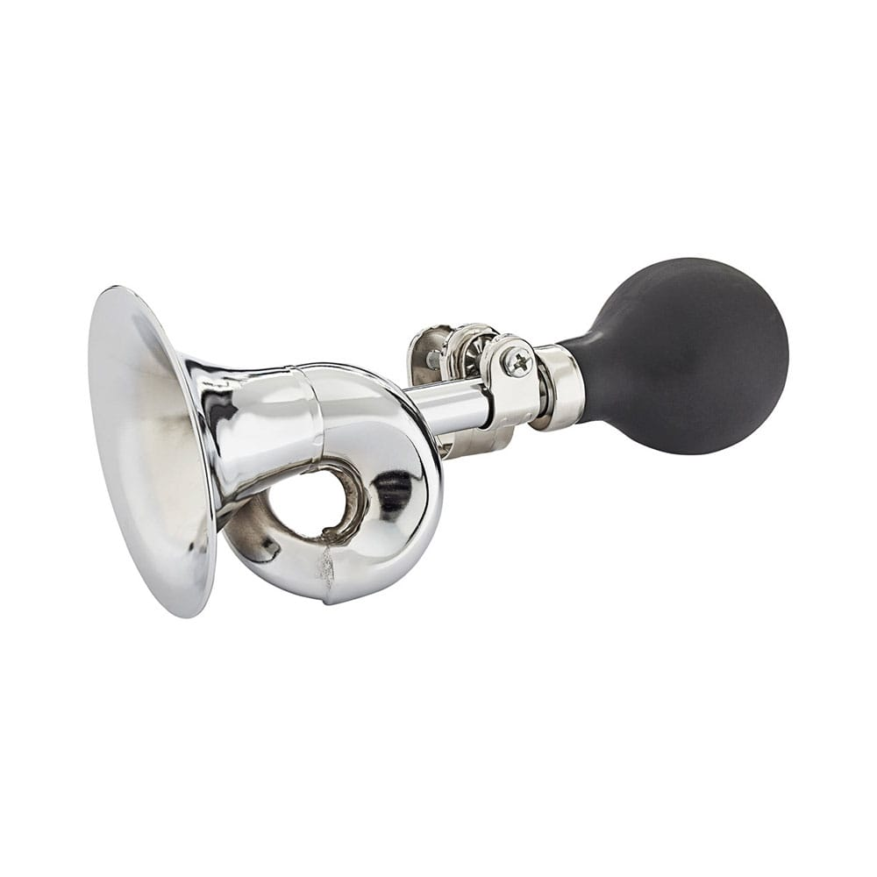
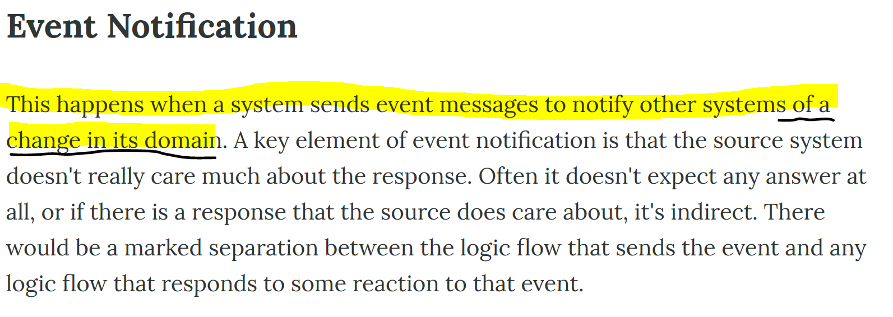
Event notificatie

Slide 22
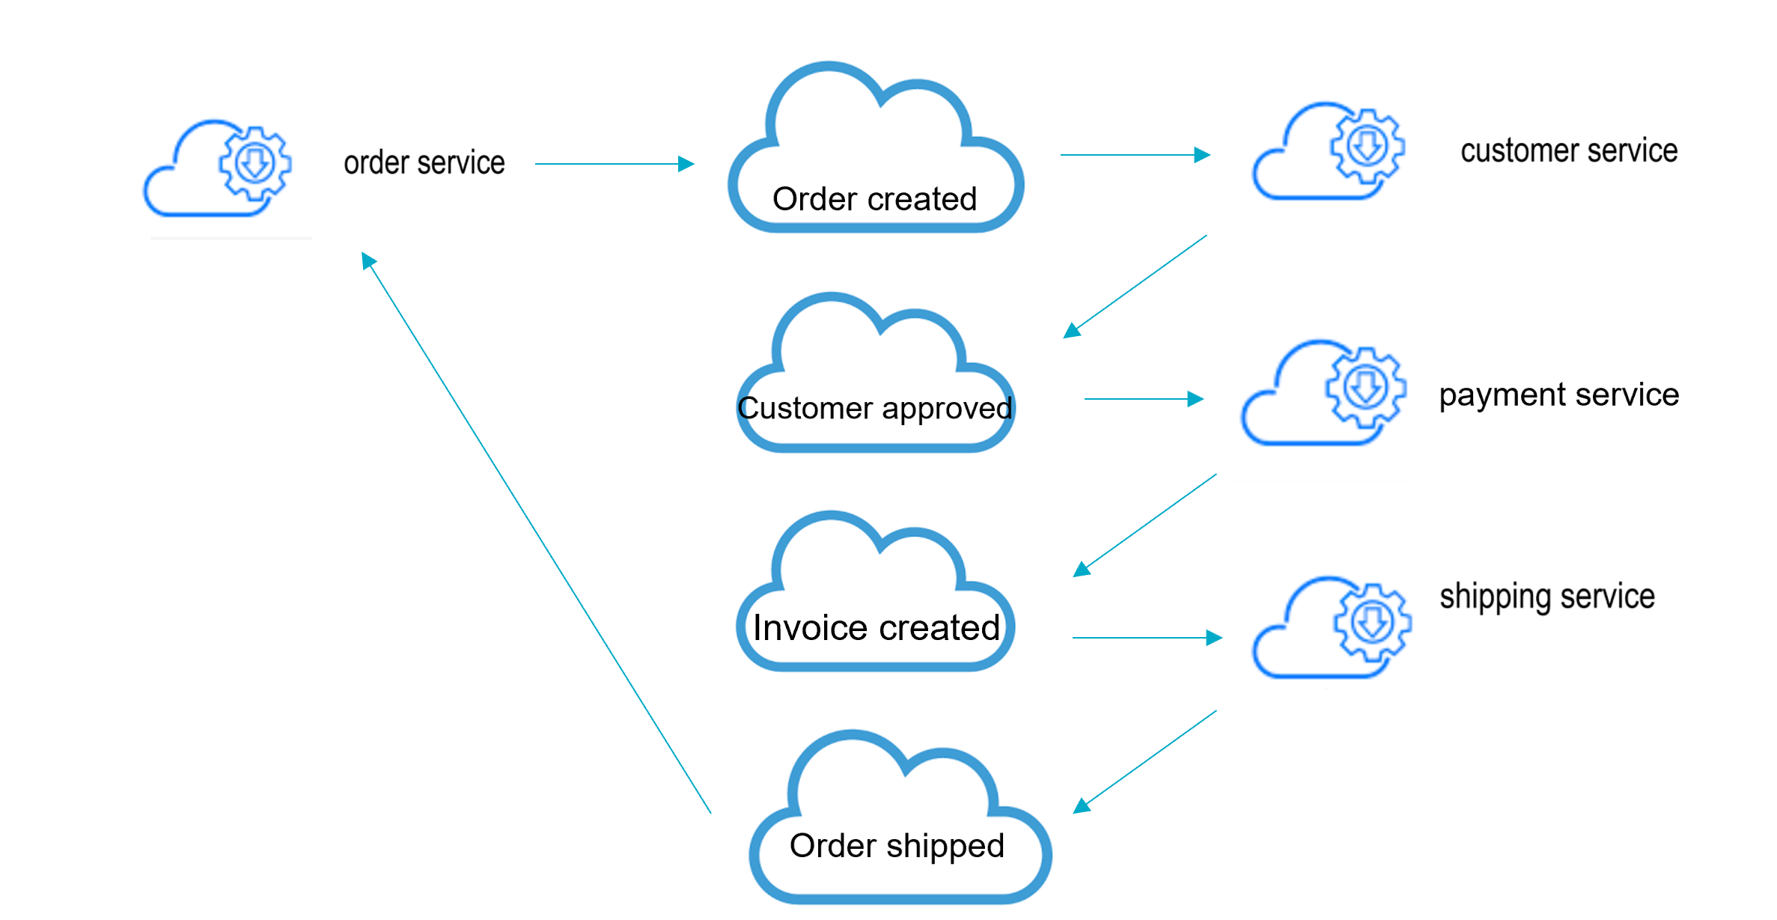
Event driven choreography

Slide 23

?

Slide 24
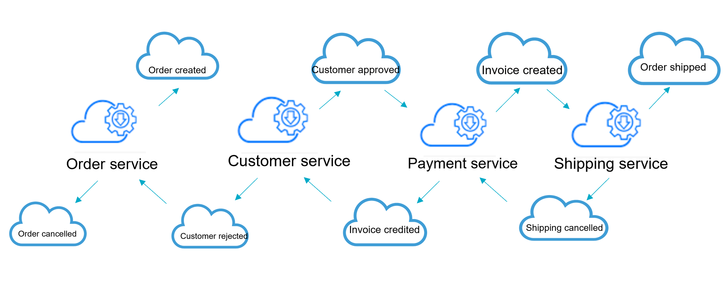
Compensating events
Undo the work performed by a series of steps, which together define an eventually consistent operation

Slide 25

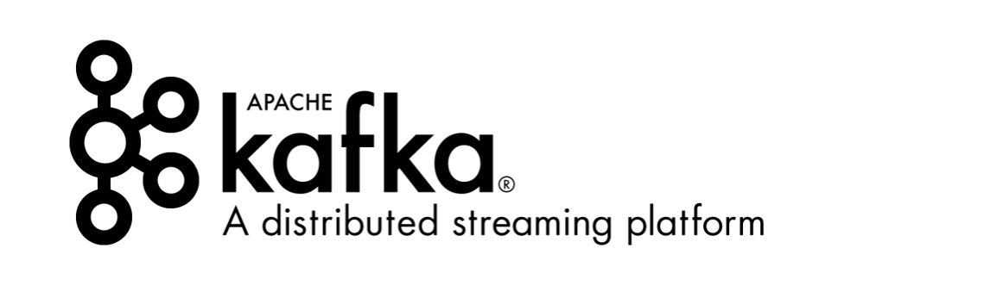
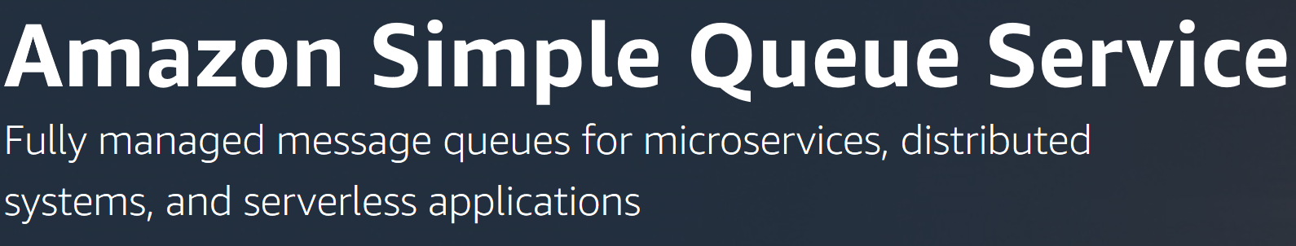

Messaging infrastructure

Slide 26
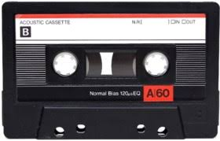
Event sourcing

Slide 27
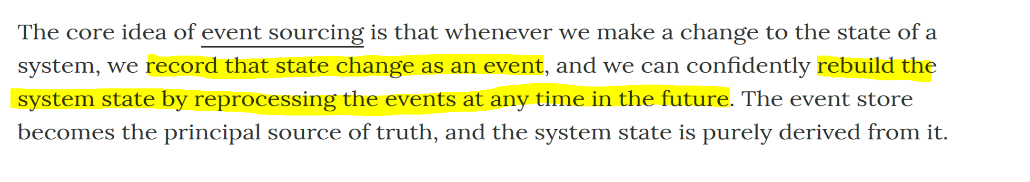
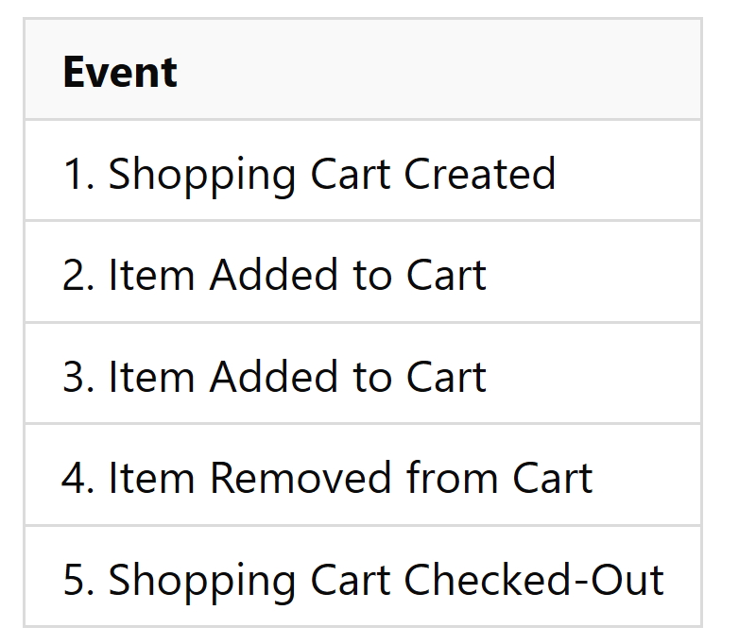
Event sourcing
Event sourcing preserves history and therefor
keeps track of business critical information!

Slide 28
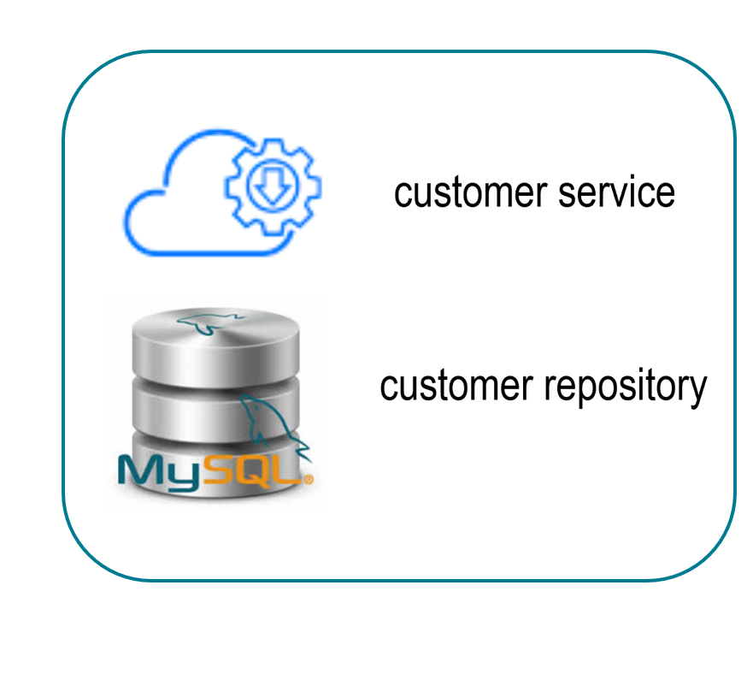
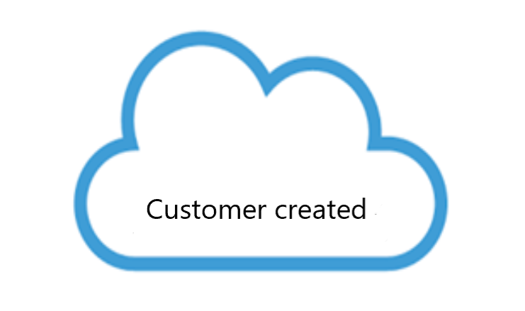
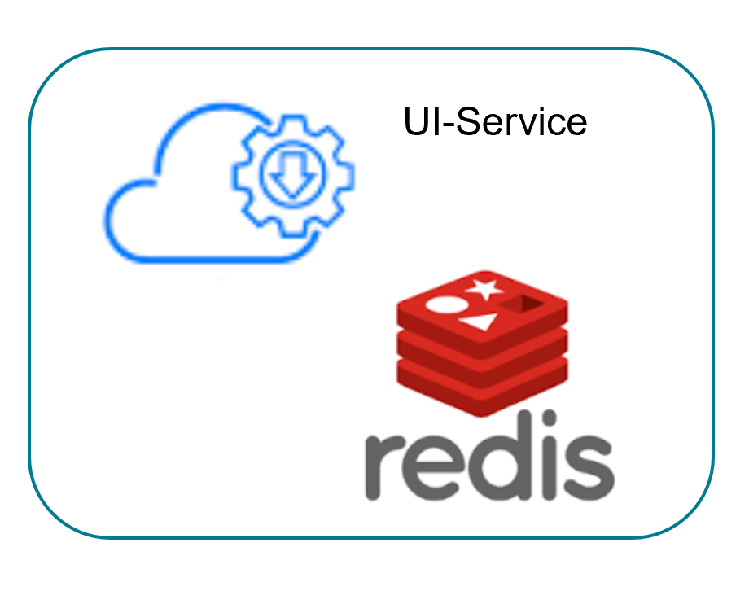
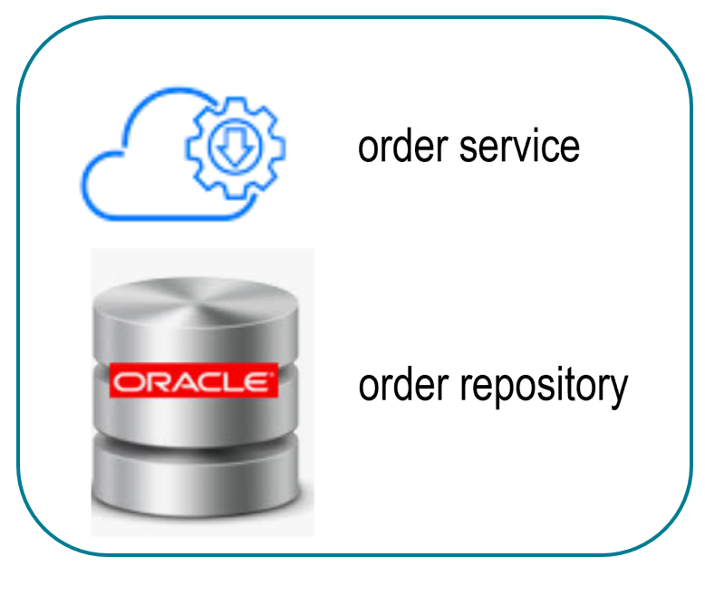
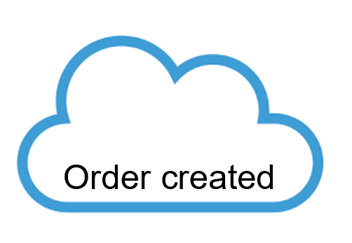
CQRS
Command Query Responsibily Segregation
At its heart is the notion that you can use a different model to update information than the model you use to read information

Slide 29


Projections
CQRS (Command Query Responsibility Segregation) allows you to have separate models for reading and writing. Combining that pattern with Event Sourcing leads to a powerful capability: updating query (read) models, based on events. In real-time or rebuilding them from an existing collection of events.
‘Projecting the events’
From the event repository you replay a subset of the events.
With ES, you are no longer bound to a current table structure in a database. Need to present data in a new shape? Simply build up a new data structure from the event source, designed to answer that query.

Slide 30

Histography.io – Timeline of history

Slide 31



Event sourcing frameworks

Slide 32

Aggregaat
The aggregate is a domain-driven-design (DDD) concept that fits well within event sourcing. To put it as briefly as possible: you apply a command to an aggregate which then produces one or more events. An aggregate can populate (re-hydrate) its state by sequential application of an event stream.

Slide 33


Aggregaat
An Aggregate is an entity or group of entities that is always kept in a consistent state. The Aggregate Root is the object on top of the aggregate tree that is responsible for maintaining this consistent state. This makes the Aggregate the prime building block for implementing a Command Model in any CQRS based application.
2 Types:
Event sourced
As-is

Slide 34
Aggregaat: commands en events
Command handler(s)
This is where business logic is implemented and events are published
Event handler(s)
This is where state is managed
Query handler(s)
For data retrieval. The Q in CQRS

Slide 35
Structuur van een aggregaat
@Aggregate
public class OrderAggregate {
@AggregateIdentifier
private String orderId;
//other properties
public OrderAggregate() {
}
….(continued on next slide)
Marks the class as an aggregate
External reference point into the Aggregate instance
Default constructor

Slide 36
Structuur van een aggregaat: command handler
@CommandHandler
public OrderAggregate(CreateOrderCommand createOrderCommand){
AggregateLifecycle.apply(
new OrderCreatedEvent(
createOrderCommand.orderId,
createOrderCommand.xxxx));
}
Annotates this constructor method as a command handler
Aggregate lifecycle class in Axon framework
@CommandHandler
protected void on(UpdateOrderStatusCommand updateOrderStatusCommand){
AggregateLifecycle.apply(
new OrderUpdatedEvent(
updateOrderStatusCommand.orderId,
updateOrderStatusCommand.orderStatus));
}
Normal method can be annotated as well

Slide 37
Command handler (=business logic)
@CommandHandler
public void handle(CreateOrderCommand createOrderCommand) {
if (createOrderCommand.getAmount() <= 0) {
throw new IllegalArgumentException("amount <= 0");
}
AggregateLifecycle.apply(
new OrderUpdatedEvent(
updateOrderStatusCommand.orderId,
updateOrderStatusCommand.orderStatus));
}

Slide 38
Event handler (=state)
The @EventSourcingHandler is what tells the framework that the annotated function should be called when the Aggregate is 'sourced from its events’.
As all the Event Sourcing Handlers combined will form the Aggregate,
this is where all the state changes happen.
@EventSourcingHandler
protected void on(OrderCreatedEvent orderCreatedEvent){
this.orderId = orderCreatedEvent.orderId;
this.xxxx = orderCreatedEvent.xxxx;
}
The event object must contain a property+value with the aggregate id
Changes the state of the aggregate object

Slide 39
SAGAs
A Saga is a special type of Event Listener:
one that manages a business transaction.
A Saga is nothing but a sequence of local transactions, that are occurring at the service level.
Sagas react to changes in the process (the events)
Can be long running (and therefor have state of their own)
Typically, and contrary to regular event listeners, a saga has a starting point and an end, both triggered by events. While the starting point of a saga is usually very clear, there could be many ways for a saga to end.

Slide 40

SAGA (orchestrated)

Slide 41

SAGA : Java code with Axon framework

Slide 42


Events sourced architectures ?

Slide 43
Handson
https://github.com/AMIS-Services/sig-saga-pattern

